Slide 1
FMCG Sales Analytics Presentation

Slide 2
Meet our team
From Group 4
Mr. Shubham Kumar Rai
Miss. Vaishali Jayawantrao Salunkhe
Mr. Rushikesh Kshirsagar
Ms. V. Asha
Mr. Aditya Naik
Mentor- Mr. Mahendra Singh

Slide 3
Agenda
Introduction
About Data Visualization
KPI
Summary

Slide 4
Introduction
Welcome to the introduction of our FMCG Sales Dashboard, a powerful tool designed to revolutionize how we monitor and Analyse sales performance in the Fast-Moving Consumer Goods (FMCG) industry.
This dashboard provides a comprehensive and interactive view of our sales data, enabling us to make data-driven decisions, improve sales performance, and drive business growth.
Today, we will explore the various features, benefits, and components of our FMCG Sales Dashboard.

Slide 5
DATA VISUALIZATION
Data Visualization is a crucial component of FMCG Analytics.
It allows us to communicate complex data in a simple easy- to-understand way.
First we identified our Key Performance Indicators (KPIs), then gathered and analysed data and then communicated our findings effectively through data visualization.
Some of the key findings are as follows:

Slide 6
KPI’s
Total Sales
Store Wise Sales
Sales Growth
Daily Sales Trend
Brand Wise Sales
Area Manager Wise Sales
Model Wise Sales
Sales Comparison
Product Wise Sales

Slide 7

Total Sales
One of the first key metrics we track in our FMCG Sales Dashboard is the Total Sales, which provides an overview of the overall revenue generated by our products or services.
This metric is vital for assessing the financial health and success of our business.

Slide 8
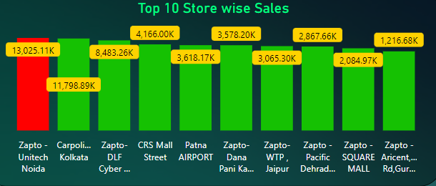
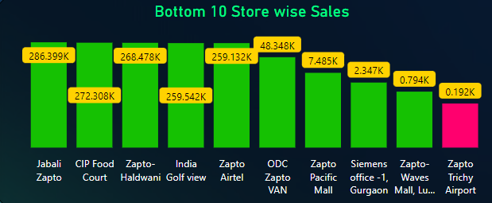
Store Wise Sales
Highest Sales – Zapto Unitech Noida:
Zapto Unitech Noida stands out as the store with the highest sales among all our locations.
The exceptional performance of Zapto Noida indicates its effectiveness in attracting customers, delivering excellent service, and meeting their needs and preferences.
Lowest Sales - Zapto Trichy Airport:
On the other hand, Zapto Trichy Airport has been identified as the store with the lowest sales performance.
Understanding the factors contributing to the low sales at this particular location is crucial for implementing targeted improvements.

Slide 9
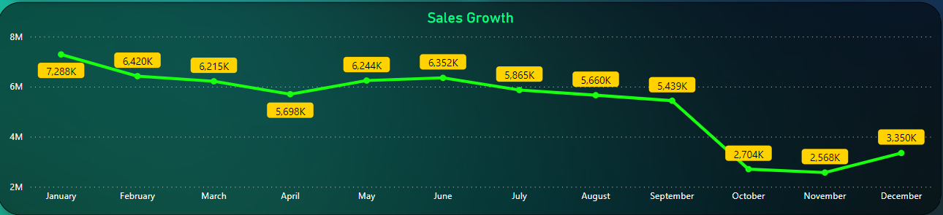
Sales Growth
Here, we track the sales growth on a month-to-month basis to understand the performance trends throughout the year.
This analysis allows us to identify the months with the highest sales growth and those with the lowest growth, providing insights into the seasonality and overall sales performance.
January emerges as the month with the highest sales growth among all the months.
The exceptional performance during January signifies that it is a strong sales period for our FMCG products.
On the other hand, November exhibits the lowest sales growth among all the months.
The lower sales growth during November indicates a comparatively slower period for our FMCG products.

Slide 10
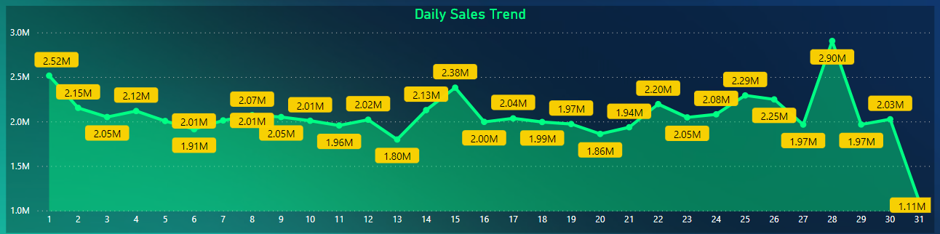
Daily Sales Trend
The Daily Sales Trend analysis in our FMCG Sales Dashboard provides a comprehensive view of sales performance on a daily basis.
This analysis allows us to track sales patterns, identify peak and slow periods, and gain insights into the daily revenue generation.
The Daily Sales Trend analysis provides valuable insights into the day-to-day revenue generation and sales patterns within a selected month.
By utilizing slicers to change the month, we can dynamically analyse the daily sales trend, identify peak and slow sales days, and uncover patterns and trends.

Slide 11
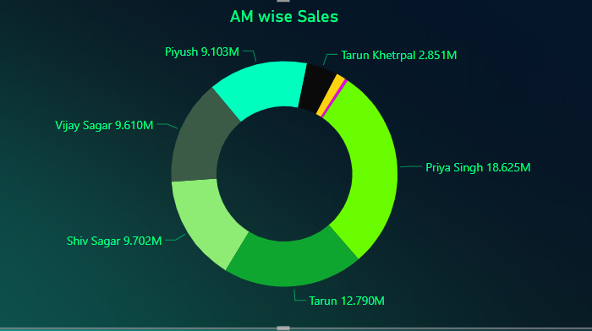
Area Manager Wise Sales
The Area Manager-wise Sales analysis in our Dashboard provides insights into the sales performance of different area managers.
This analysis allows us to evaluate the contributions of individual area managers, identify top performers, and address areas for improvement.
The Area Manager-wise Sales analysis provides insights into the performance of individual area managers in our Dashboard.
Priya Singh stands out as the top performer, while Tarun Khetrpal has the lowest sales performance among the area managers.
By leveraging the success of top performers and supporting underperformers, we can drive overall sales growth, foster a culture of excellence, and maximize the potential of our area managers.

Slide 12
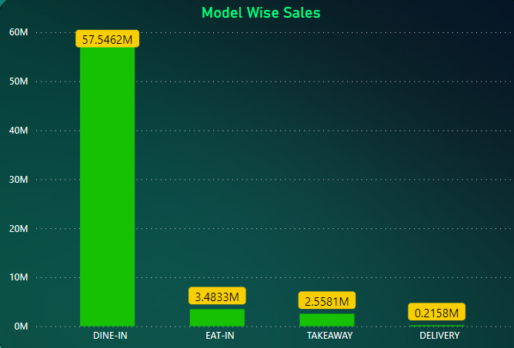
Model Wise Sales
Among the four service models, DINE-IN stands out with the highest sales, generating up to 57.546 million in revenue.
This indicates that a significant portion of our customer base prefers the dine-in experience, which is reflected in the strong sales performance for this model.
On the other hand, DELIVERY has the lowest sales, generating only 0.2158 million in revenue.
Understanding the reasons behind the lower sales for delivery will help us identify areas for improvement and implement strategies to enhance customer adoption and sales in this service model.
The Model-wise Sales analysis offers valuable insights into sales performance across different service models, including DELIVERY, DINE-IN, EAT-IN, and TAKEAWAY.
DINE-IN stands out as the service model with the highest sales, while DELIVERY has the lowest sales.
Leveraging the success of DINE-IN and focusing on improving the performance of DELIVERY can contribute to overall sales growth and customer satisfaction.

Slide 13
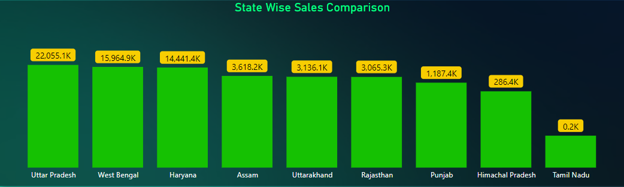
Sales Comparison
Among all the states, Uttar Pradesh emerges as the top performer with the highest sales.
This indicates that Uttar Pradesh presents a significant market opportunity and demonstrates strong customer demand for our FMCG products in the region.
On the other hand, Tamil Nadu has the lowest sales among all the states, indicating potential challenges or factors impacting sales performance in this region.
The Sales Comparison by States analysis allows us to optimize our regional strategies based on sales performance across different states.
By understanding the strengths and weaknesses of each state, we can allocate resources, refine marketing efforts, and tailor our sales strategies to meet the unique demands of specific regions.
This approach ensures that we maximize our sales potential, address regional variations, and capitalize on market opportunities across different states.

Slide 14
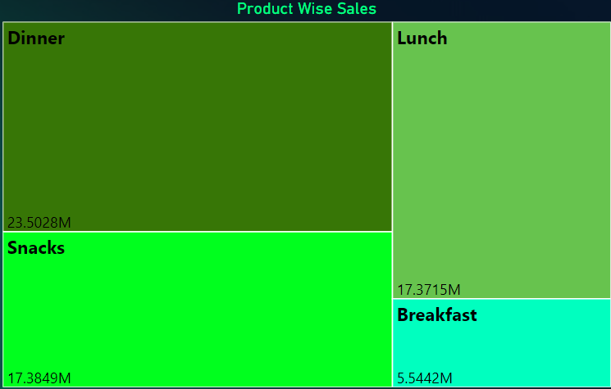
Product Wise Sales
This analysis allows us to understand customer preferences, evaluate the popularity of different product categories, and optimize our sales strategies accordingly.
Among the four product types, Dinner stands out with the highest sales, indicating its popularity among our customers.
On the other hand, Breakfast has the lowest sales among the product types, indicating relatively lower customer demand for breakfast-related FMCG products.
Lunch and Snacks have comparably equal sales, suggesting a similar level of customer interest and engagement with these product categories.

Slide 15
Conclusion
Our FMCG Sales Dashboard provides a comprehensive view of sales performance, enabling data-driven decision-making.
By analysing store-wise sales, we can identify top-performing stores and areas for improvement.
Month-wise sales growth highlights peak and slow periods, allowing us to optimize resources and plan targeted strategies.
Area Manager-wise sales analysis helps identify top performers and support underperformers for overall sales improvement.
Product-wise sales analysis enables us to leverage successful categories, address challenges, and optimize our product offerings.

Slide 16
Thank You

